Slide 1
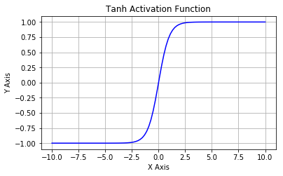
Hyperbolic Tangent

Slide 2
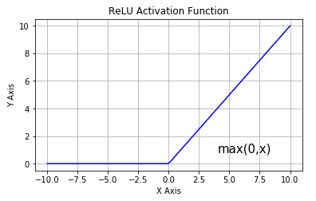
Rectified Linear Unit

Slide 3
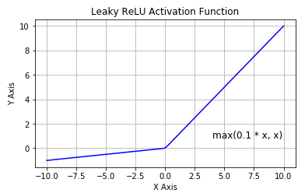
Leaky ReLU

Slide 4
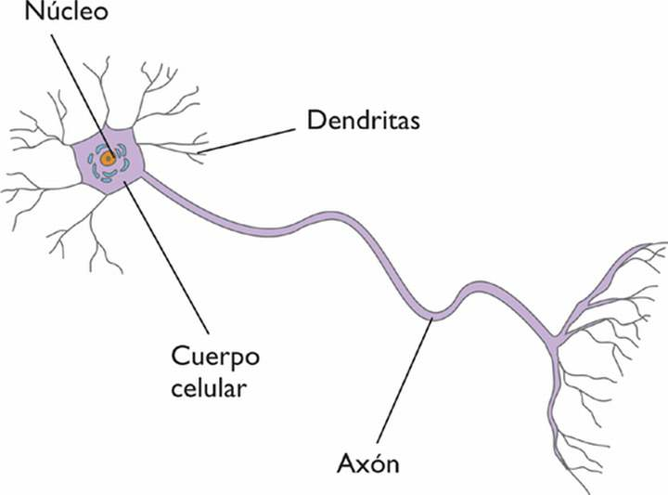
Neurona vs Perceptron

Slide 5
Perceptron

Slide 6
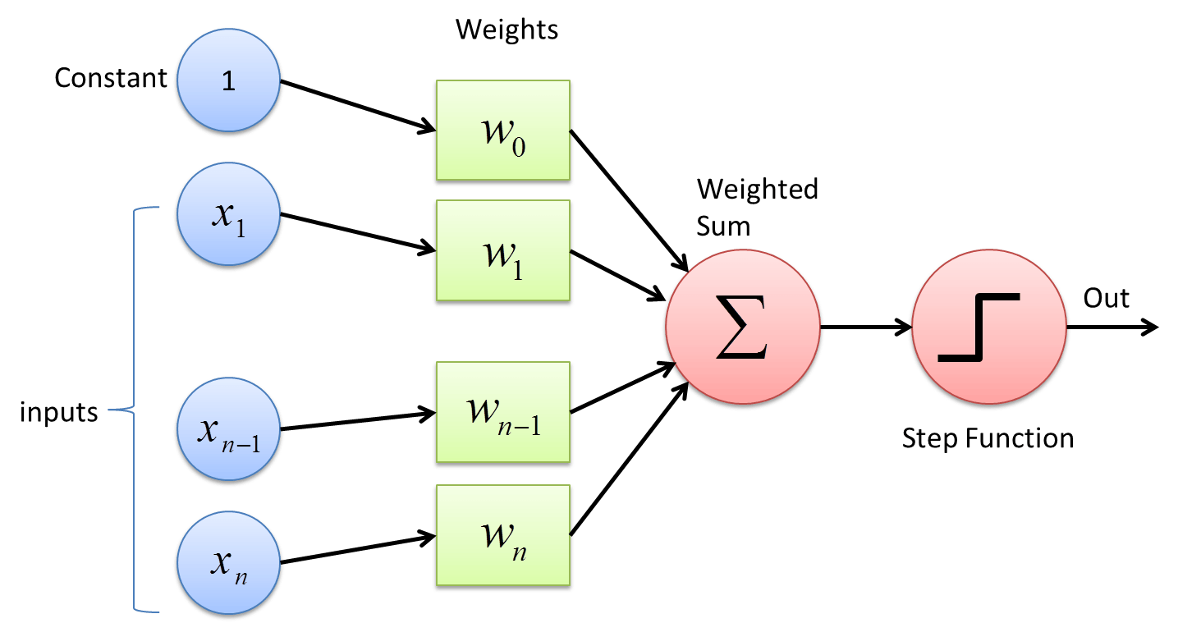
Perceptron

Slide 7
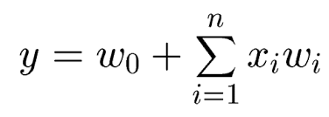
Perceptron

Slide 8
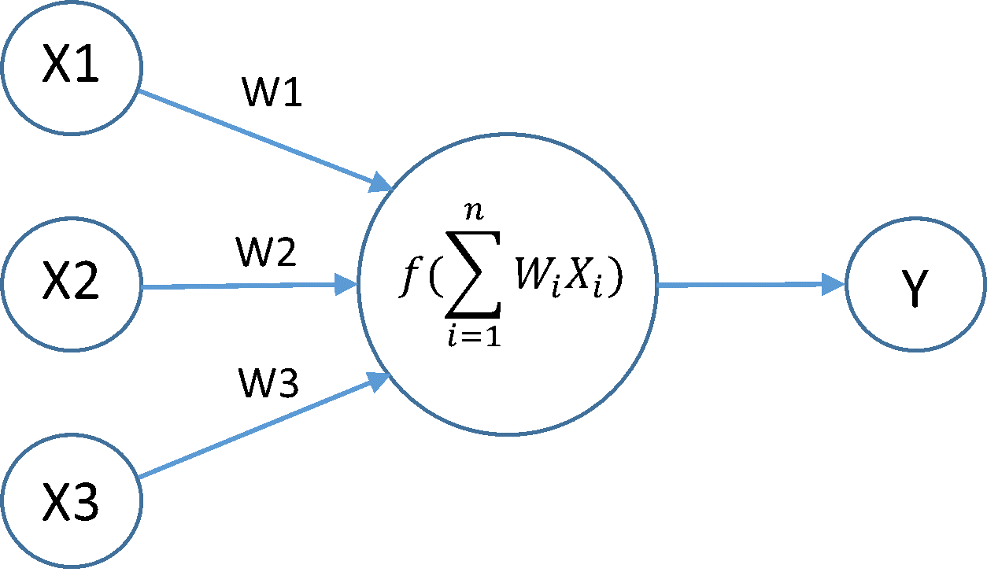
Perceptron

Slide 9
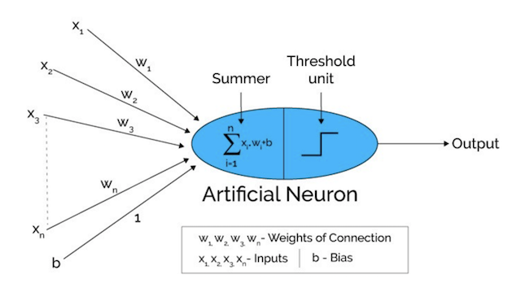
Perceptron
Activation function

Slide 10
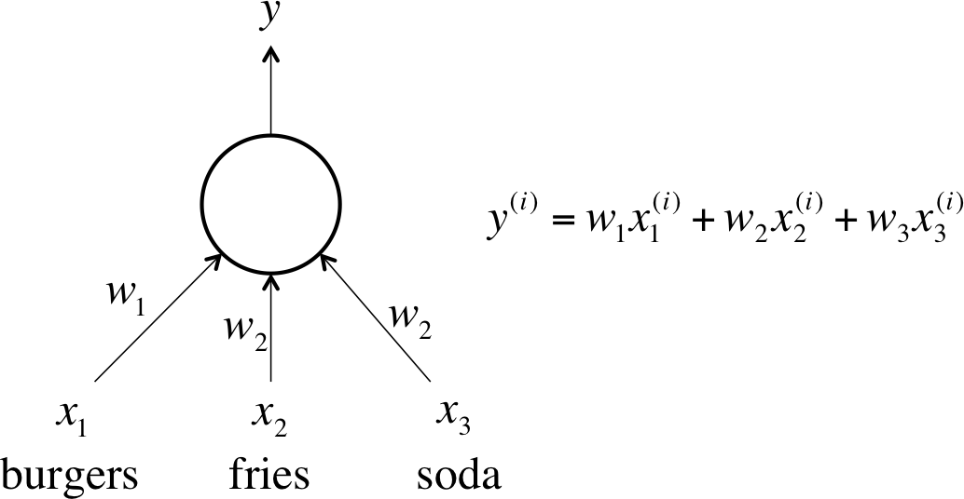
Perceptron

Slide 11
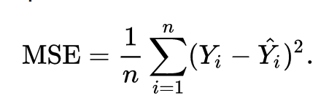
Perceptron
11
4
5
10
886
MSE=552049
143
7
7

Slide 12
Perceptron
11
55.0633
12.076197
10
886
MSE=0.307020161
886.554094
22.870832
7

Slide 13
Hyperbolic Tangent

Slide 14
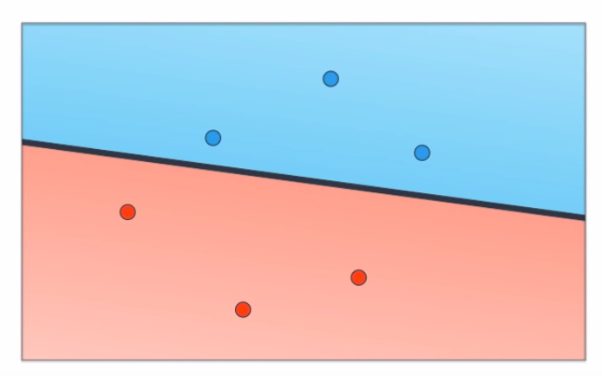
Classification

Slide 15
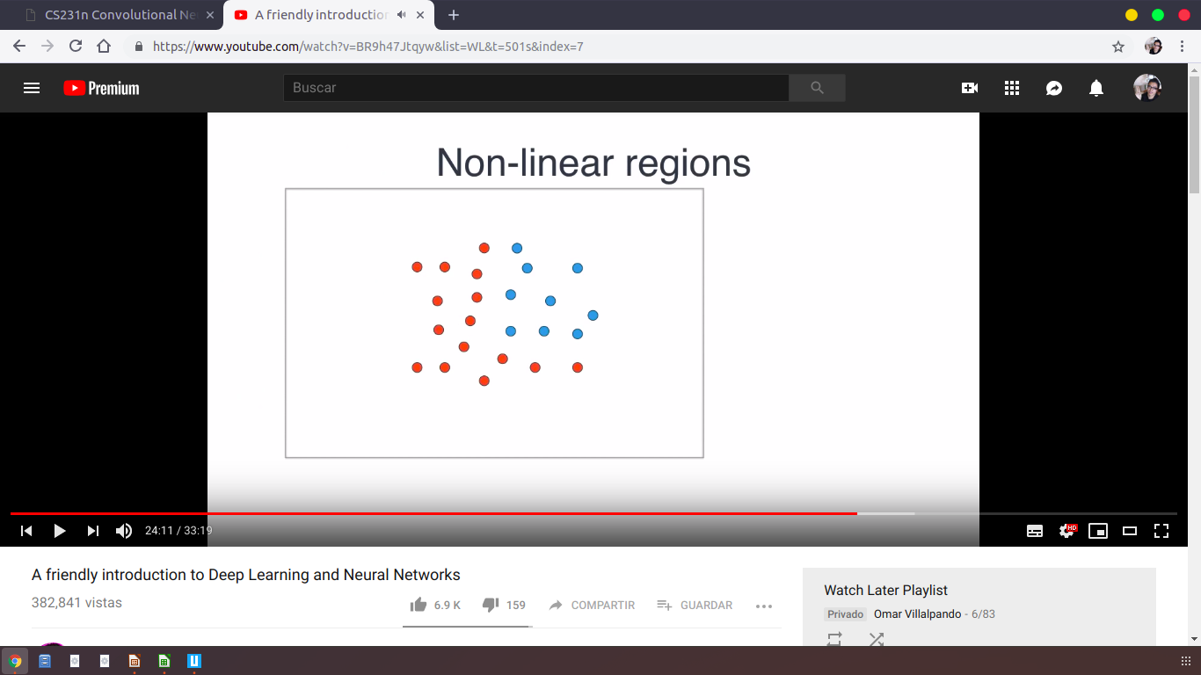

Slide 16
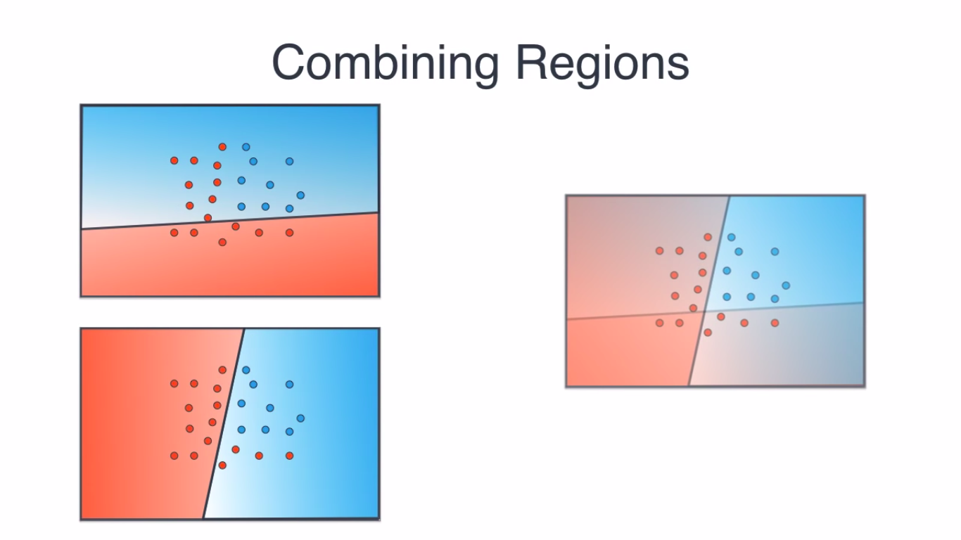

Slide 17
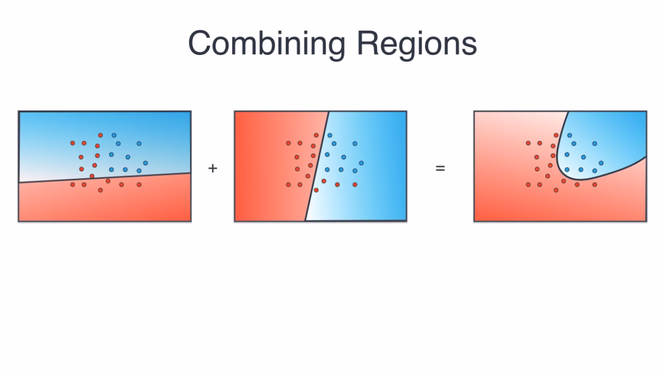

Slide 18
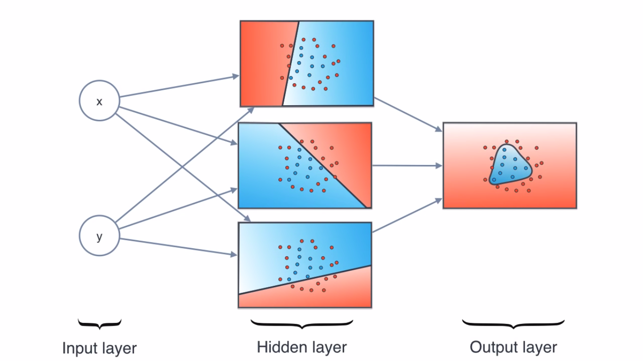

Slide 19
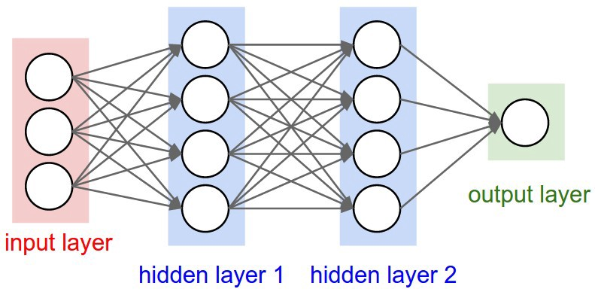
Neural network architecture

Slide 20
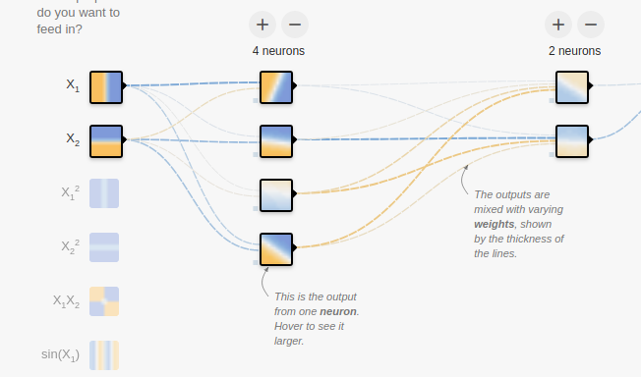
https://playground.tensorflow.org/

Slide 21
